Slide 1
Project Presentation
Ruslan Khalitov
PhD Candidate, Department of Computer Science
TDT4173 Machine Learning
Fall 2023

Slide 2
Outline
Purpose and task overview
Aneo
Data and task details
Evaluation
Virtual Teams
What should be delivered?
Grading

Slide 3
Purpose
Learn how to solve real-world problems using machine learning models.
Learning goals:
Data manipulation
Feature engineering
ML model training lifecycle
Close the gap between «toy» and real ML problems
Solving ML competitions

Slide 4
The task
Accurately solve a prediction problem
Real-world data
You will compete with Virtual Teams (VTs) we’ve created
Better score → More VTs defeated → higher grade

Slide 5


Kaggle
The competition is hosted on Kaggle InClass
Kaggle is the largest platform for data science competitions
Why Kaggle?
You can check solutions automatically
Allows private InClass competitions for students
User-friendly interface
World-known platform

Slide 6

sdcd

Slide 7
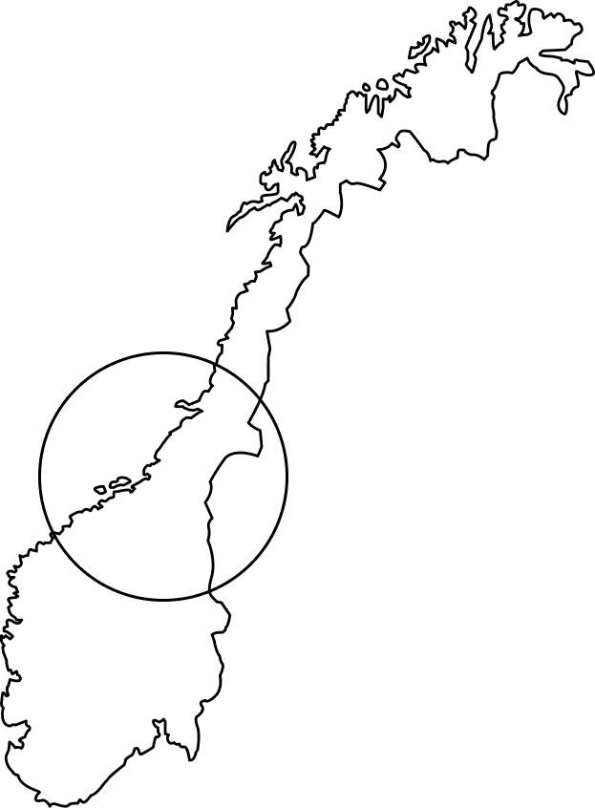
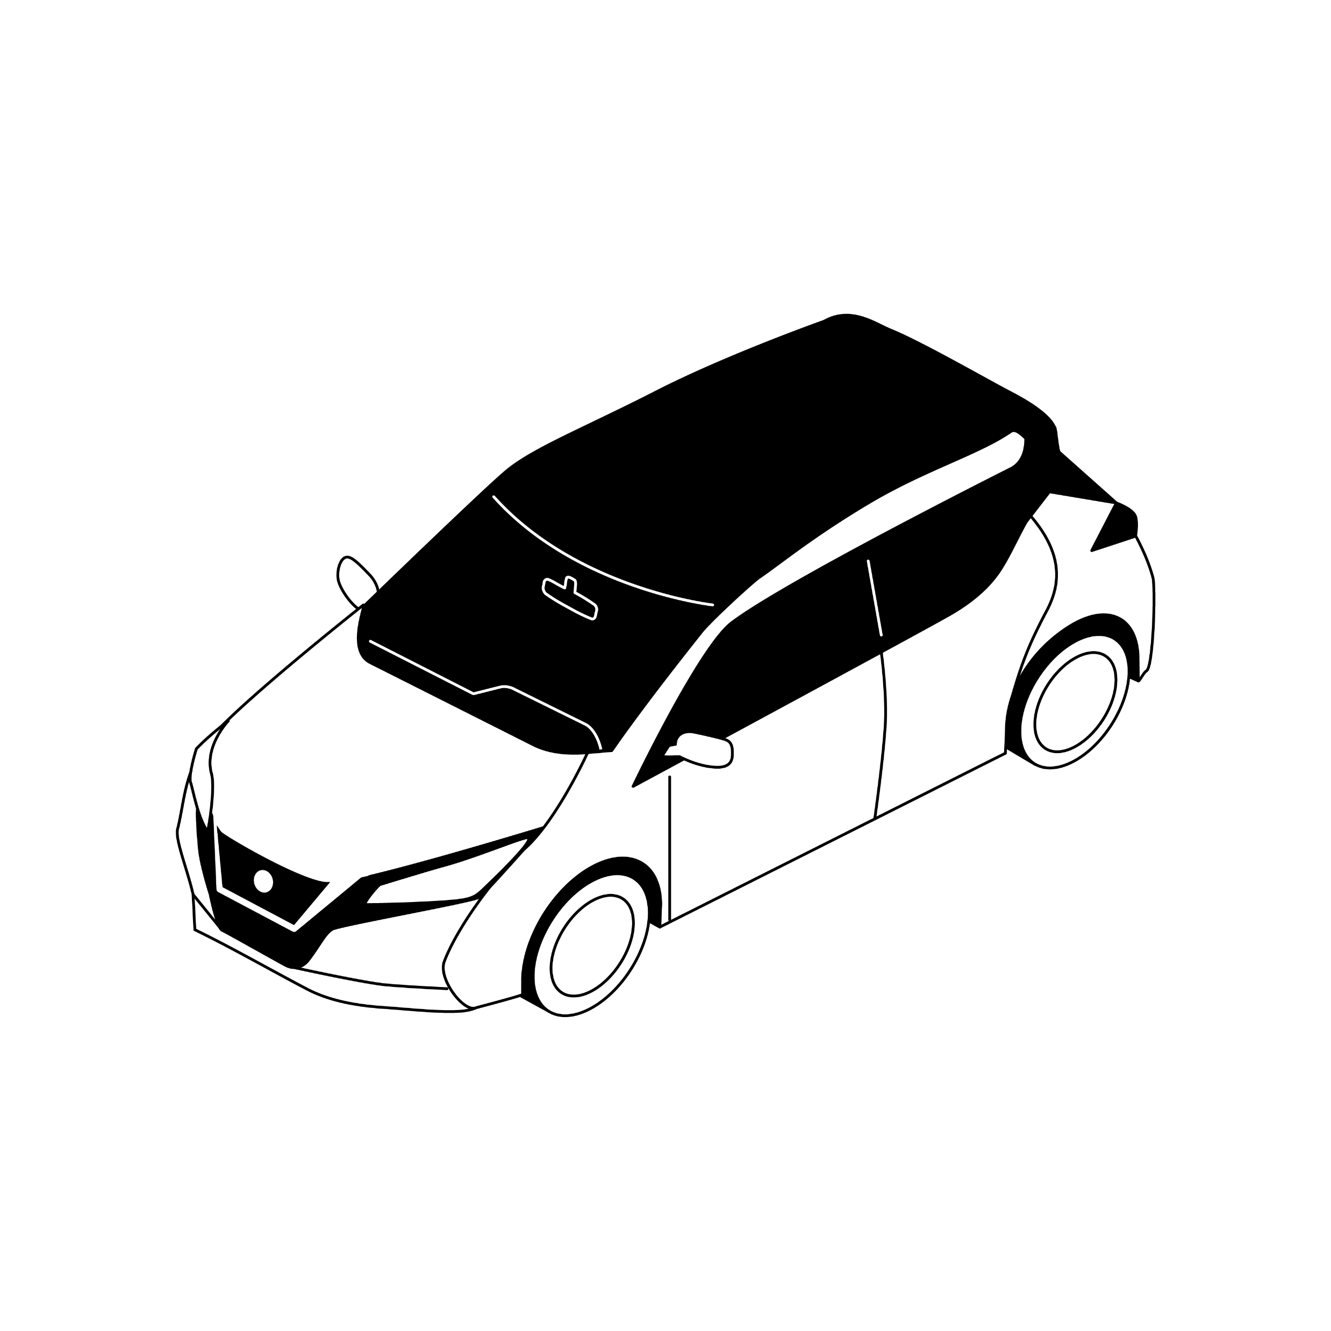
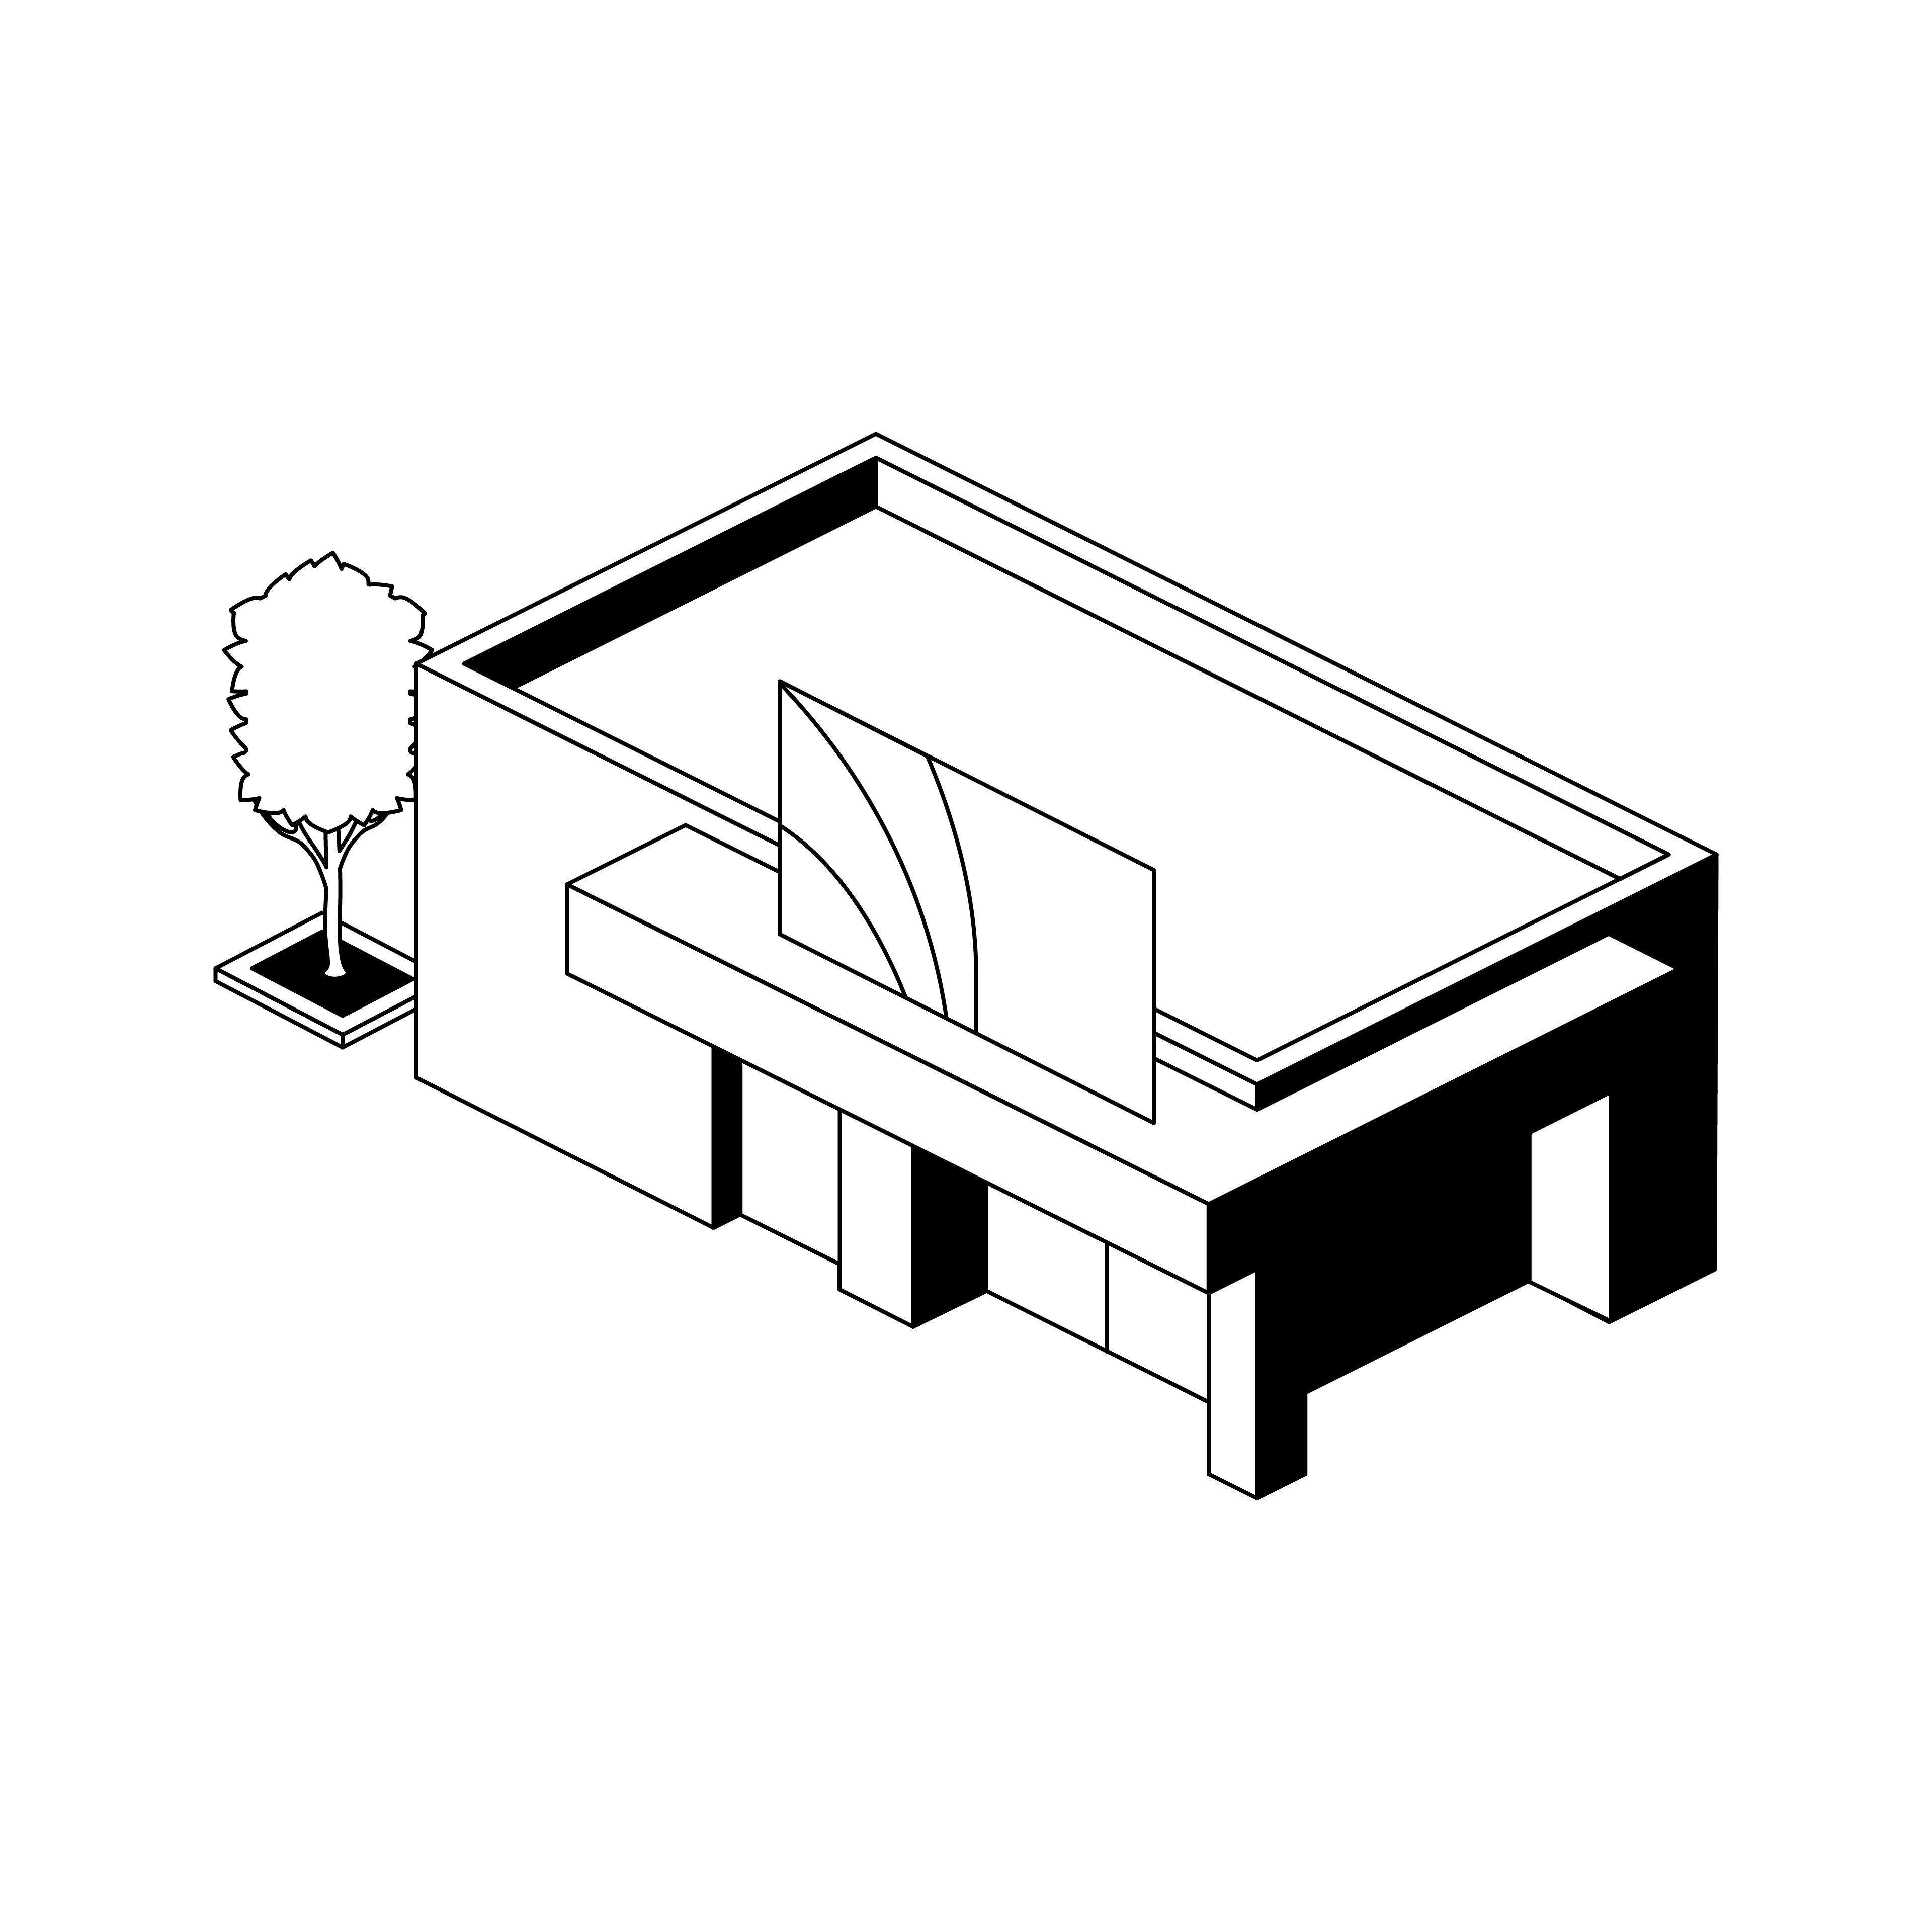


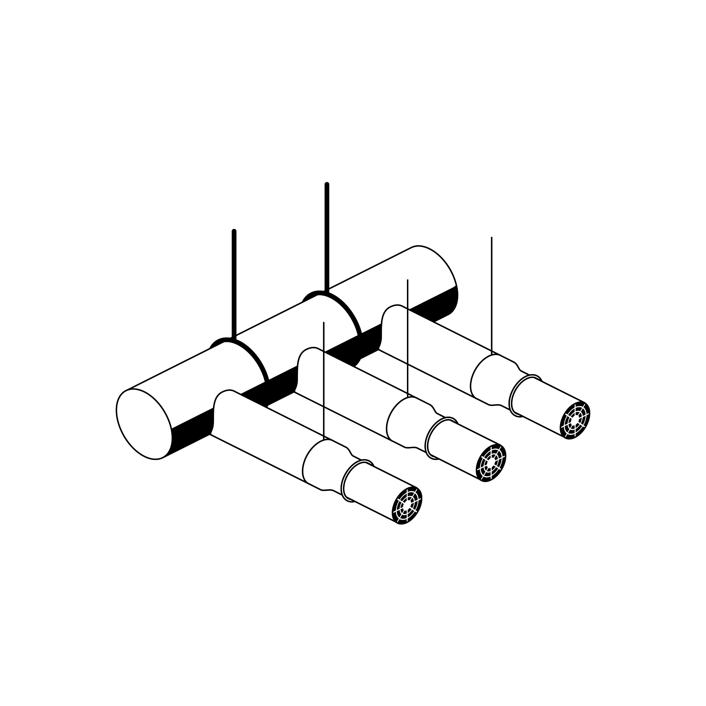
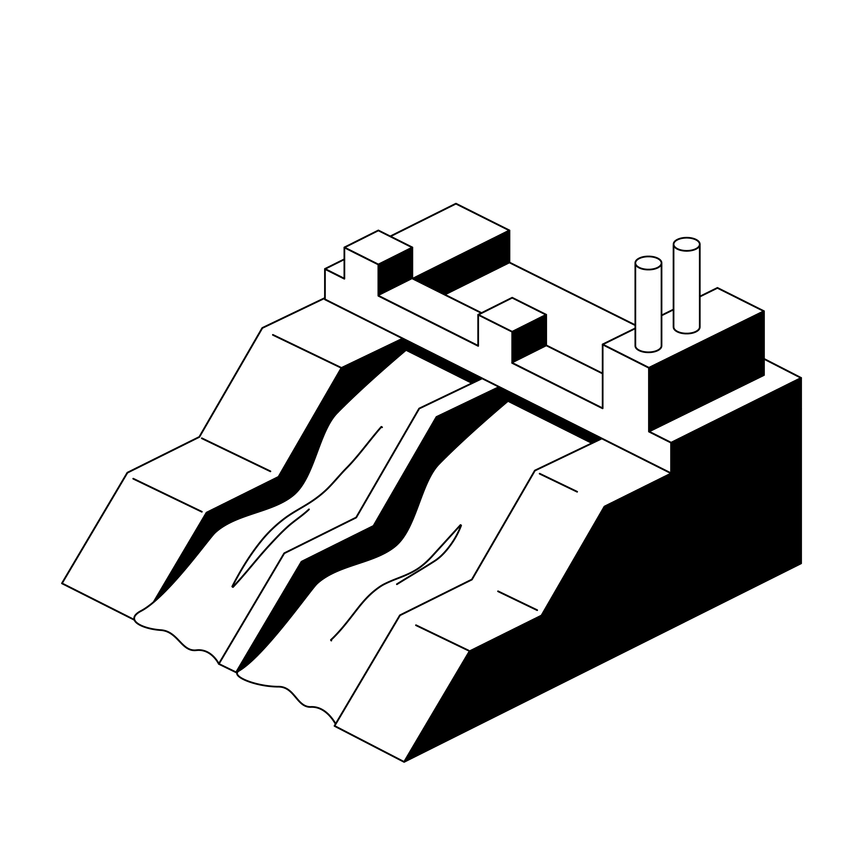


About Aneo
Norway’s second largest wind power company
Innovative downstream services
1 Aneo Mobility
EV charging solutions for housing associations and commercial customers
2 Aneo Retail
Delivers and manages sustainable energy infrastructure for retail
928 GWh annual production
Leading national centre of excellence for energy management of renewable production
Aneo Build
Delivers and manages charging containers for electrification of building and construction
4 Aneo Industry
Energy saving and zero emission solutions for process industry
6TWh under management, 1 TWh of which is for third parties
Owns 18,98% of TrønderEnergy’s hydropower production
Ownership in leading Nordic
biogas company
Substantial ownership share in Scandinavian Biogas Fuels (listed in Stockholm)
5 Aneo Real Estate
Solar energy solutions for commercial property
346 GWh annual production

Slide 8
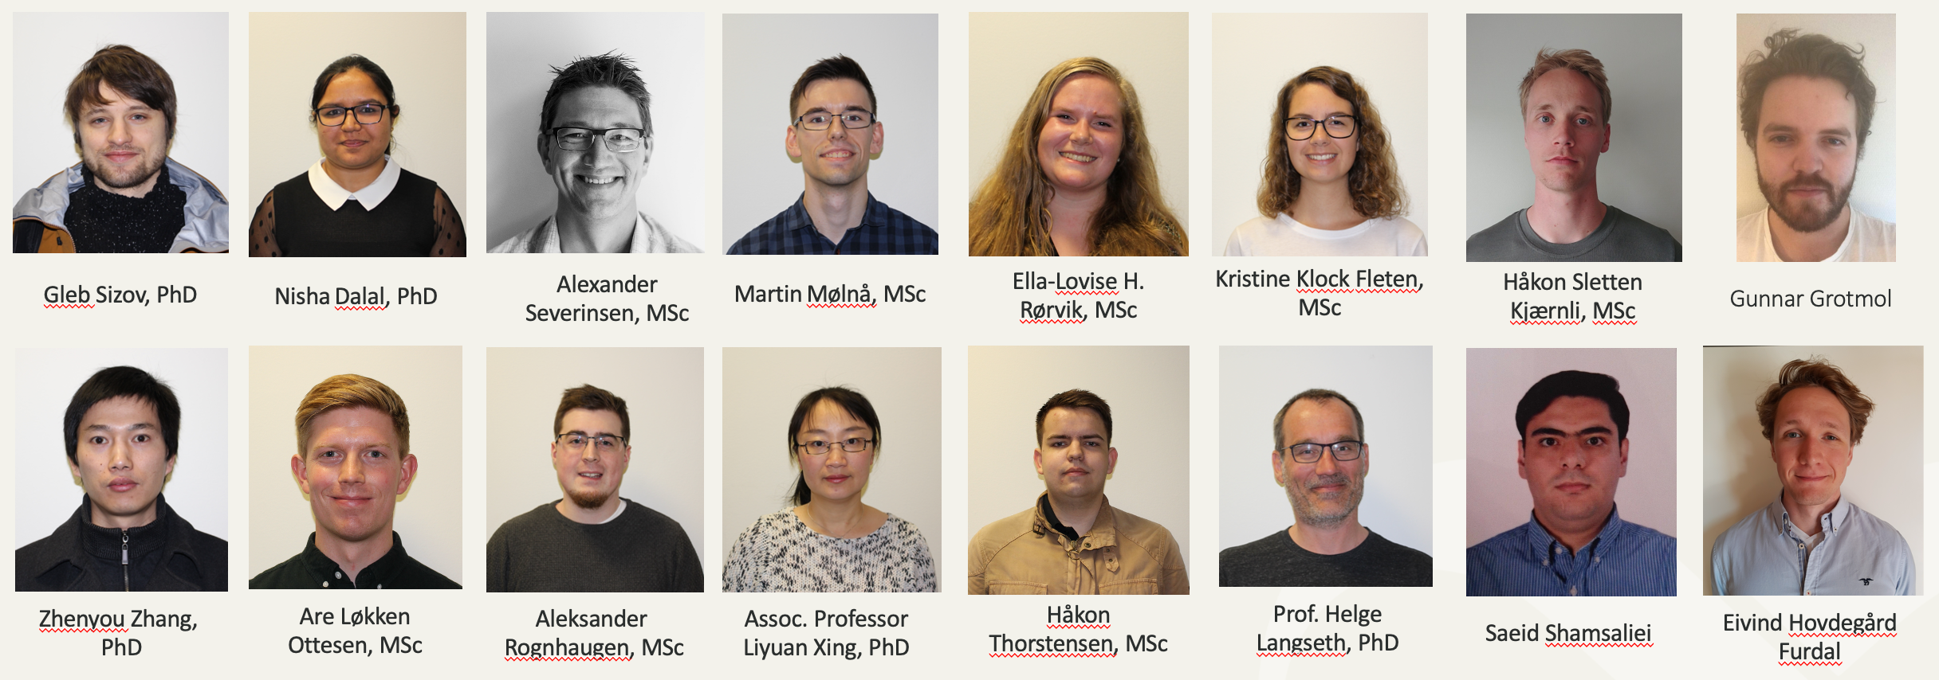


Artificial Intelligence at Aneo
Internal AI team develops energy forecasting, optimization, trading and control systems
Strong capabilities in AI are the core of Aneo's digital platform.
We leverage the value of data and AI through increased quality and efficiency in the company's core processes and activities.
With a highly skilled internal AI team, combined with domain experts we enable process improvement throughout the entire value chain.
14
Employees
6
PhDs
4
PhD students

Slide 9
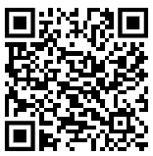
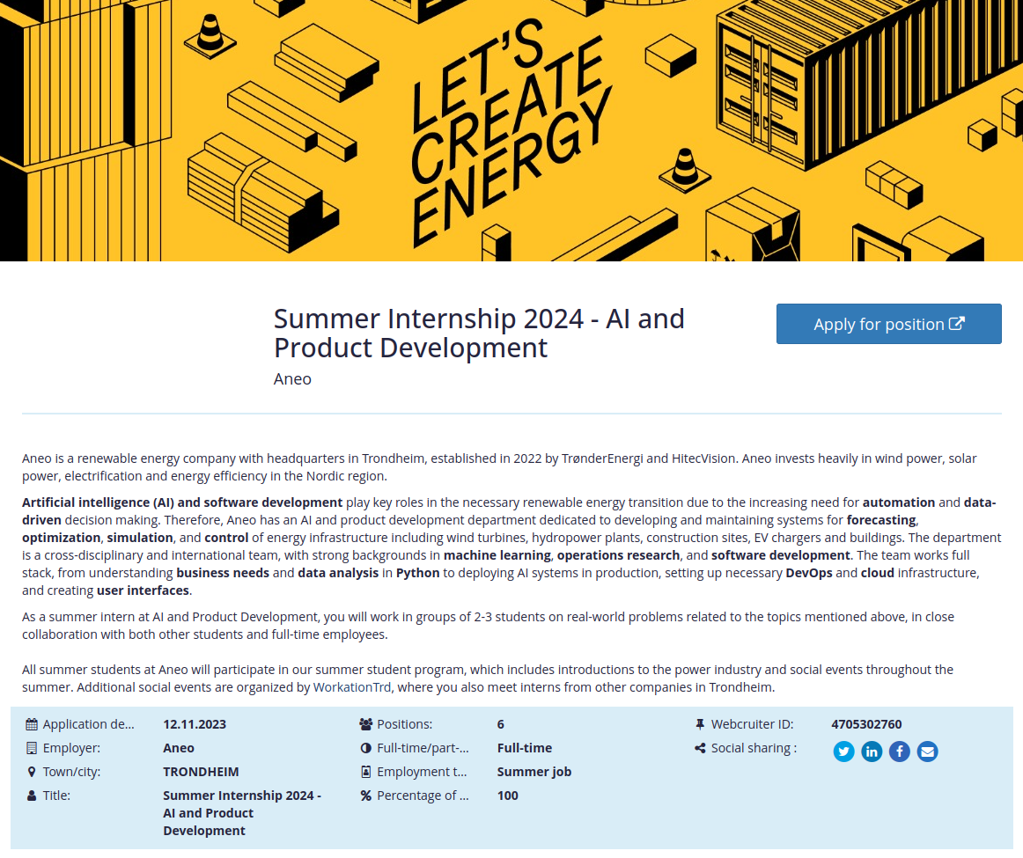
AI internships and
master projects at Aneo
Relevant topics
Probabilistic time-series forecasting​ of energy consumption and production
Condition-based monitoring for wind turbines​
Intelligent control of buildings with model predictive control and reinforcement learning
Physics-informed machine learning for heating and ventilation modeling
https://201607.webcruiter.no/Main/Recruit/Public/4705302760

Slide 10
Outline
Purpose and task overview
Aneo
Data and task details
Evaluation
Virtual Teams
What should be delivered?
Grading

Slide 11
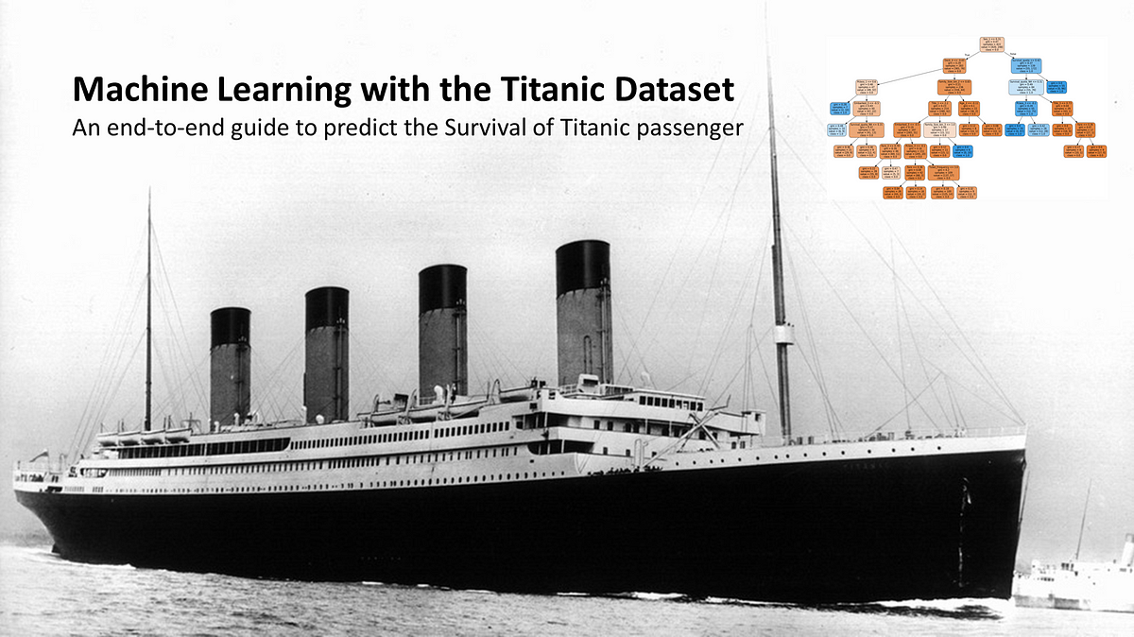
Task and data details
Task: Predict survival of Titanic passengers

Slide 12

Task and data details
Task:
build a model that can
predict solar energy production
for every hour of the next day
Problem type:
time-series forecasting, regression problem
Close to realistic production setup!

Slide 13
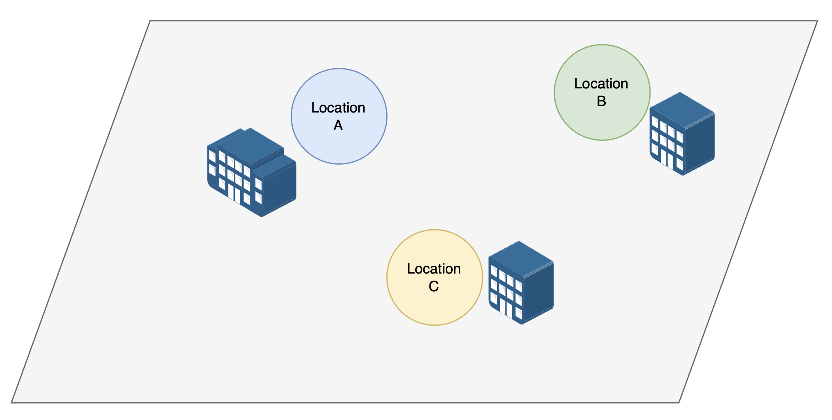

Slide 14
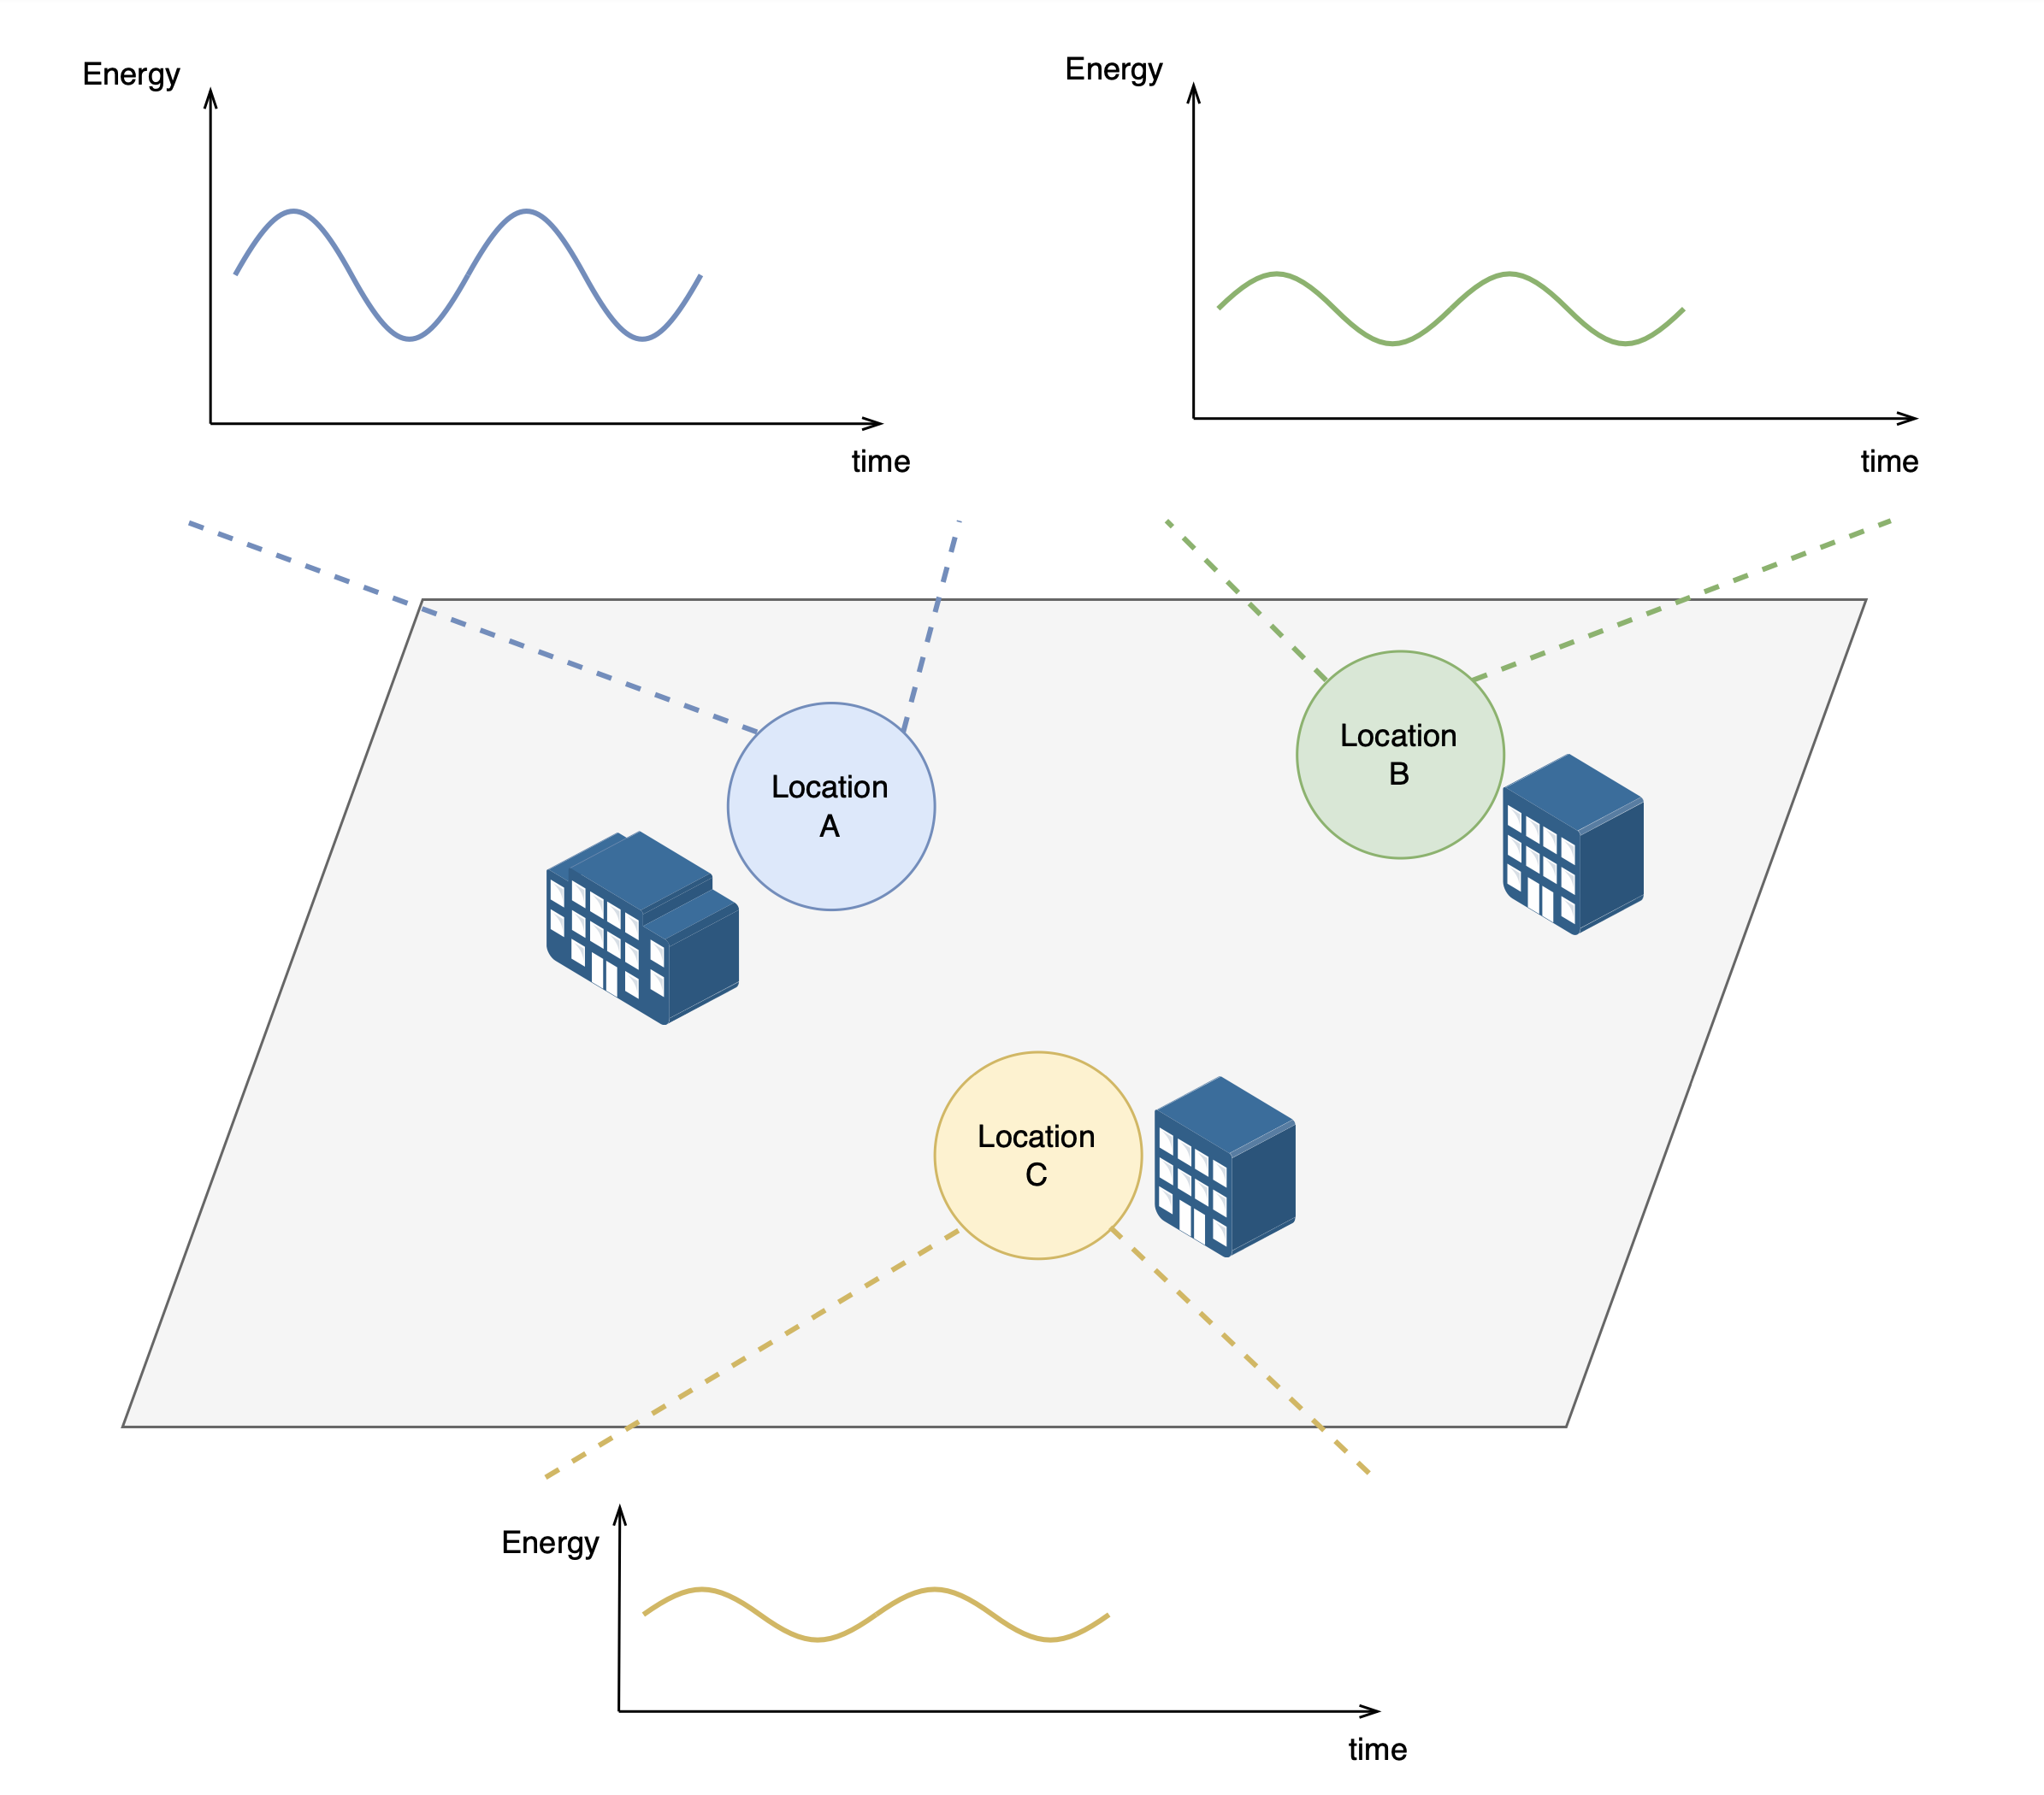

Slide 15
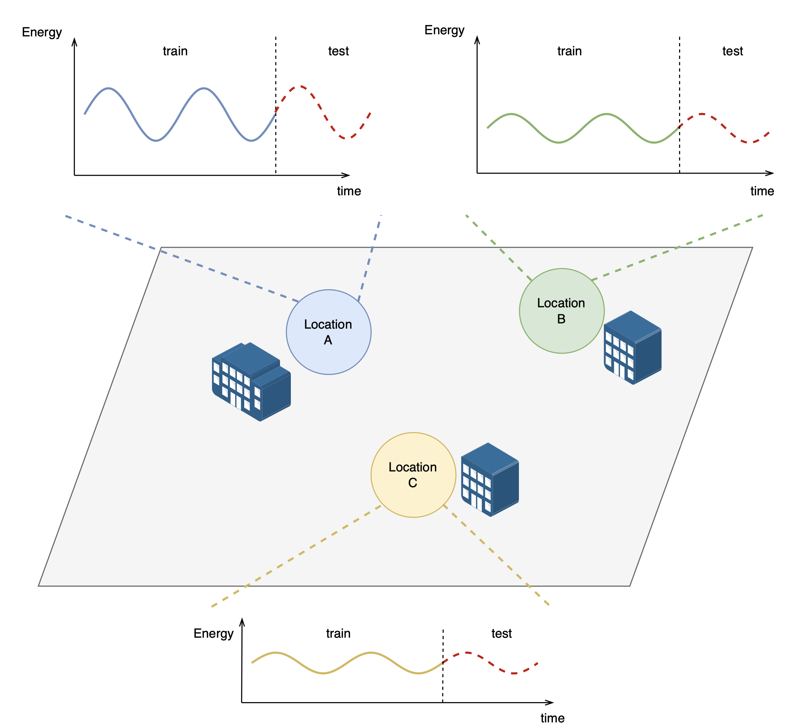

Slide 16
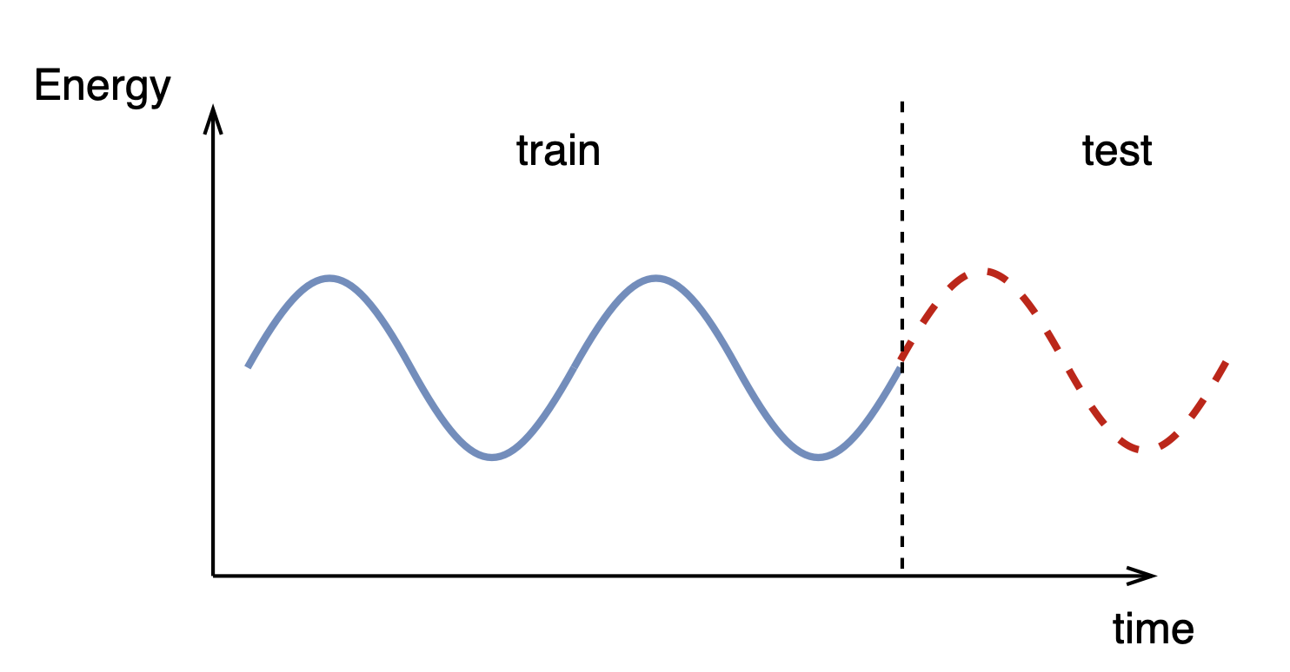
Standard TS forecasting:
Test period can be predicted accurately using only historical data.
Our task is not that straightforward.

Slide 17
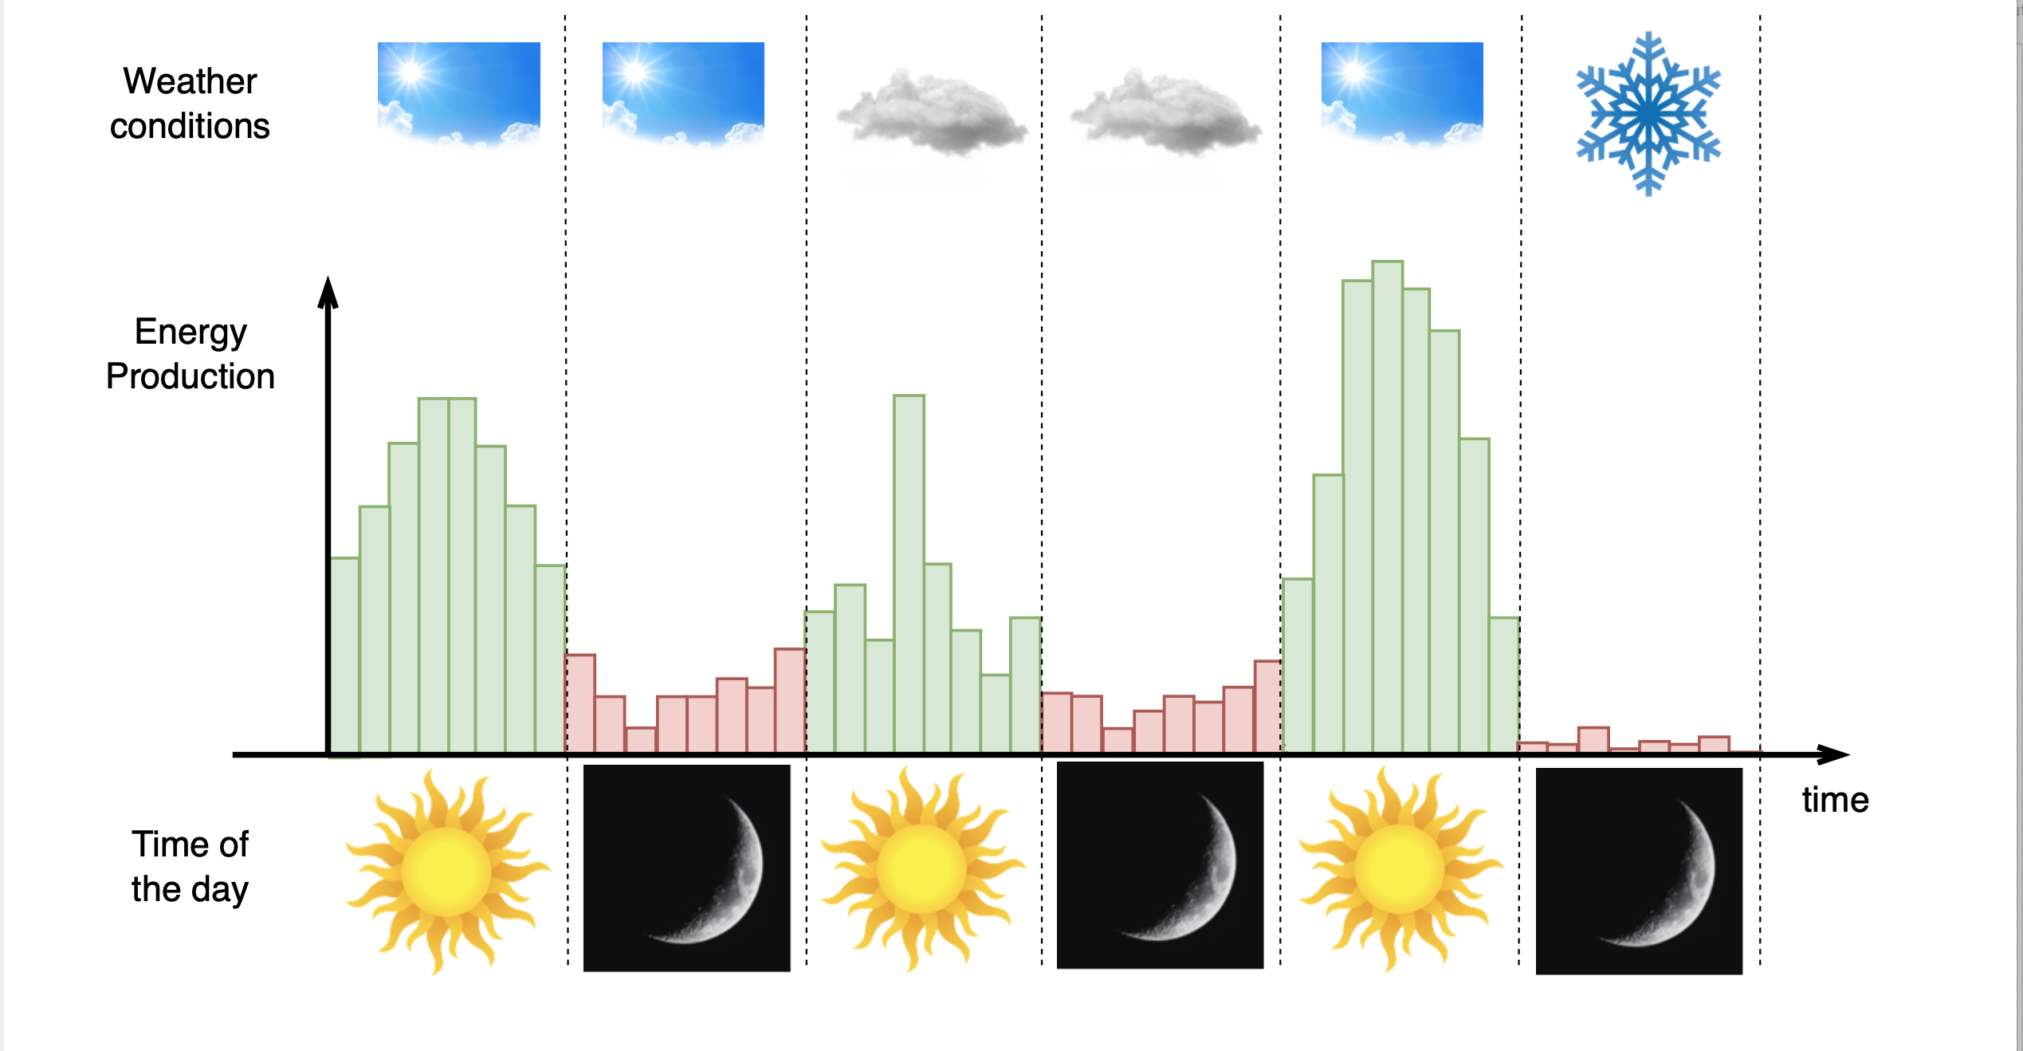
Solar energy is highly dependent on weather conditions and time

Slide 18
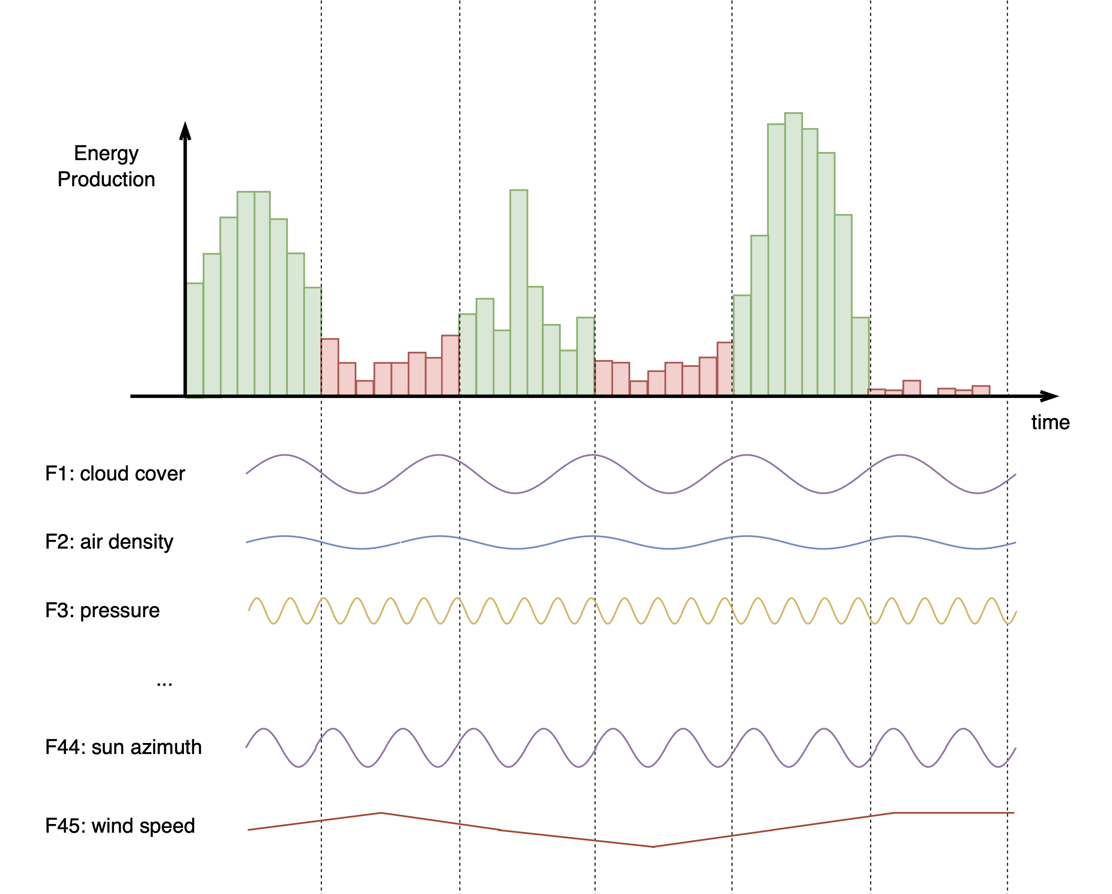
We give you 45 weather related features observed historically

Slide 19
Ytrain
Xtrain
We give you 45 weather related features observed historically

Slide 20
Ytrain
We are here now
Xtrain

Slide 21
Ytrain
Ytest
(what you need to predict)
Xtrain
Xtest
(?????)

Slide 22
Xtest
(don’t know the future)
The problem #1:
We do not know future weather
But we can use weather predictions!
Every day a meteorologist sends us his weather predictions for the next day (24 h) for all 45 features.
Your system is supposed to take these predictions as Xtest and use it to predict solar energy production Ytest.

Slide 23
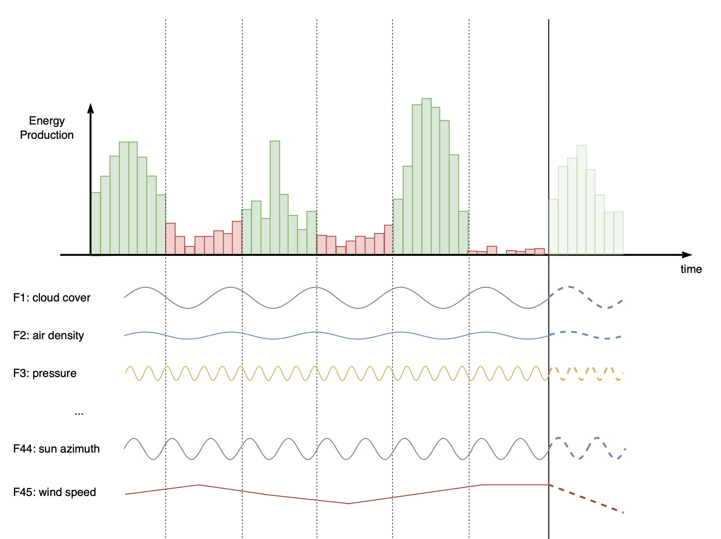
Ytest
(your predictions)
24h
Xtest
(estimated weather)

Slide 24

Weather predictions?

Slide 25
Xtest
observed
Xtest
estimated
The problem #2:
Weather predictions differ from real observed weather
～
～
If you train your model on real weather
but predict future using estimated weather there will be a risk of an error.
Your model must adapt to the distribution difference between real weather and estimated weather.

Slide 26
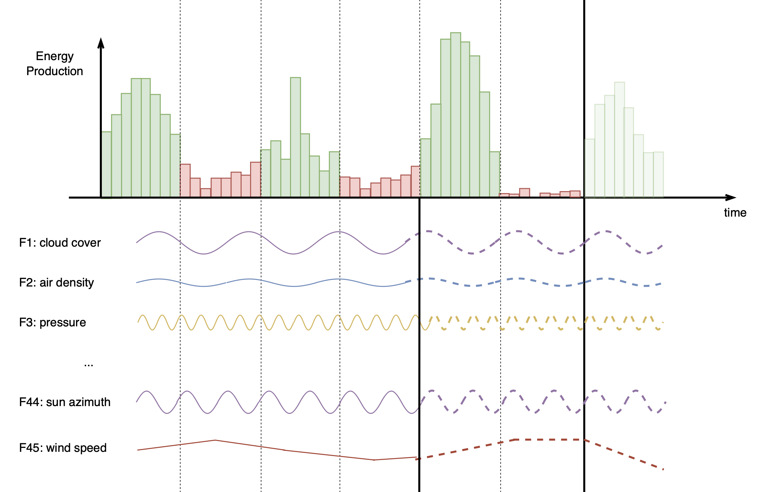

Slide 27
Ytrain
Ytest
Xtrain
(observed)
Xtrain
(estimated)
Xtest
(estim.)

Slide 28
Ytrain
Ytest
30 days
Between May 1 and July 5
2019/01/01
2022/10/28
2023/05/01
Xtrain
(observed)
Xtrain
(estimated)
Xtest
(estim.)

Slide 29

Why 30 days???
You said 24 h prediction!!!
We will imitate everyday predictions for 30 days. Imagine you trained a model and let it work without your supervision.
Y¹_{test}
Y²_{test}
Y³_{test}
Y²⁸_{test}
Y²⁹_{test}
Y³⁰_{test}
...
X¹_{test}
X²_{test}
X³_{test}
X²⁸_{test}
X²⁹_{test}
X³⁰_{test}

Slide 30
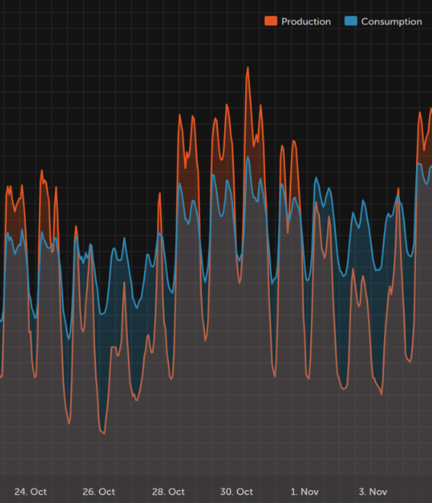
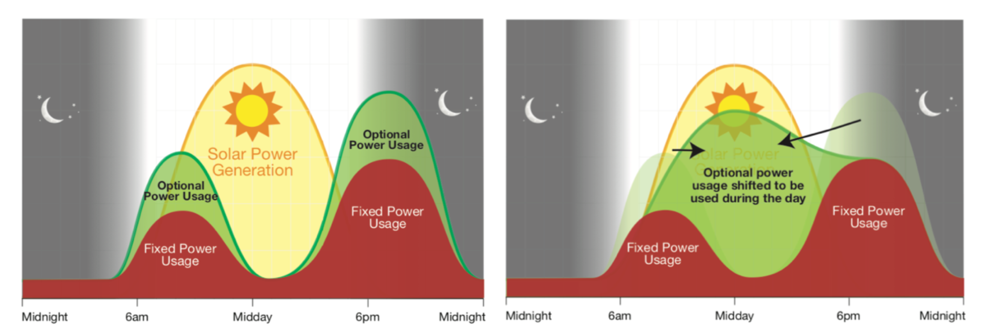
Why solar energy prediction is important for Aneo?
Aneo aims to develop up to 2 TWh of solar power by 2030
Forecasts are required to balance production and consumption, keeping the grid frequency stable and electronic devices working properly
We can use more solar energy instead of fossil fuels by moving consumption to hours with a lot of solar energy

Slide 31
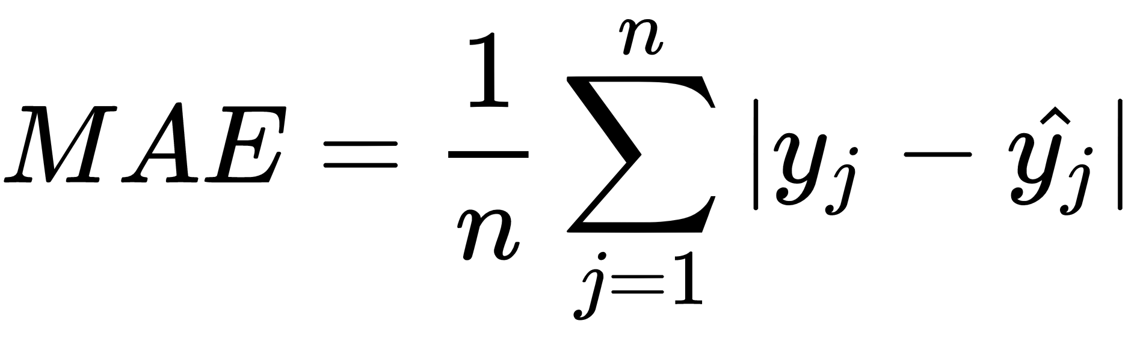
Evaluation metric
30 days
x
24 hours
x
3 locations
Mean Absolute Error

Slide 32
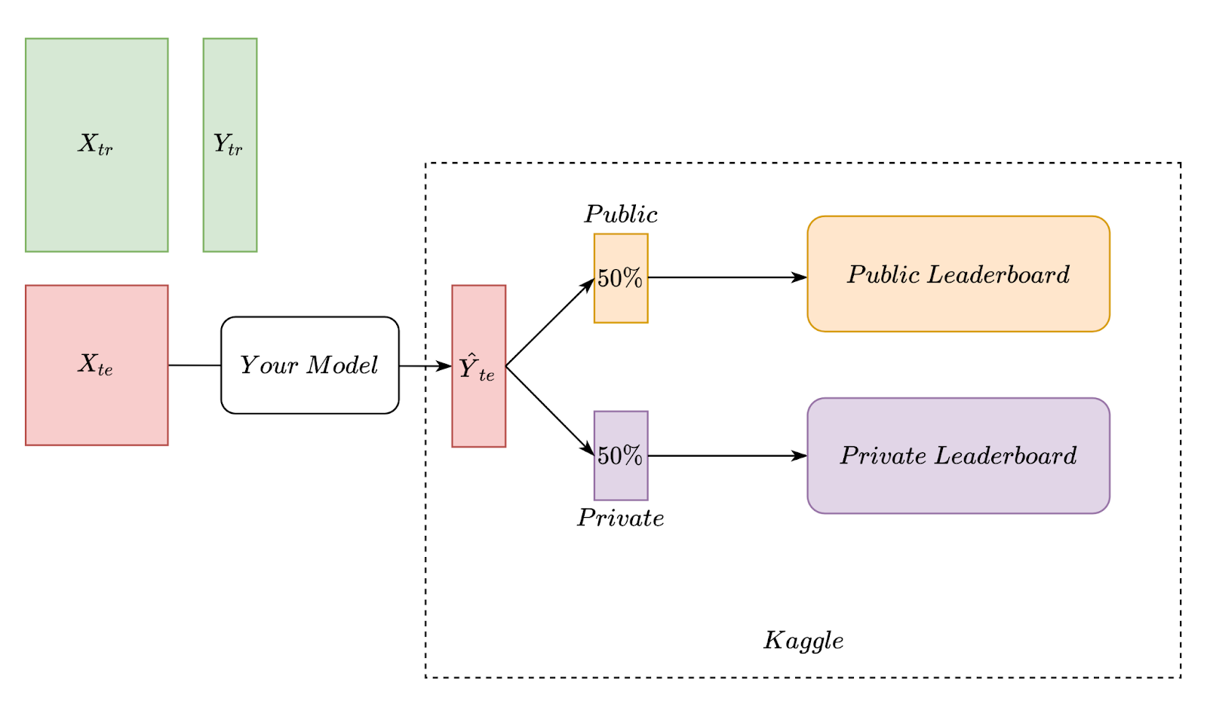
Evaluation. Public/Private

Slide 33
Evaluation. Public/Private

Slide 34
Evaluation. Public/Private

Slide 35
Evaluation. Public/Private
You will see this score instantly
After the deadline

Slide 36
Evaluation. Public/Private
You don’t know the exact Public/Private split
You can see your estimated score on the test set instantly
You can submit max 5 times per day
The final score of your solution is your Private score
Before the competition end you have to select 2 solutions:
Tip: select diverse solutions

Slide 37
Evaluation. Public/Private
You have extra information from the public leaderboard (50%)
The best public score does not necessarily correspond to the best private score
Do not overfit on the public leaderboard score

Slide 38
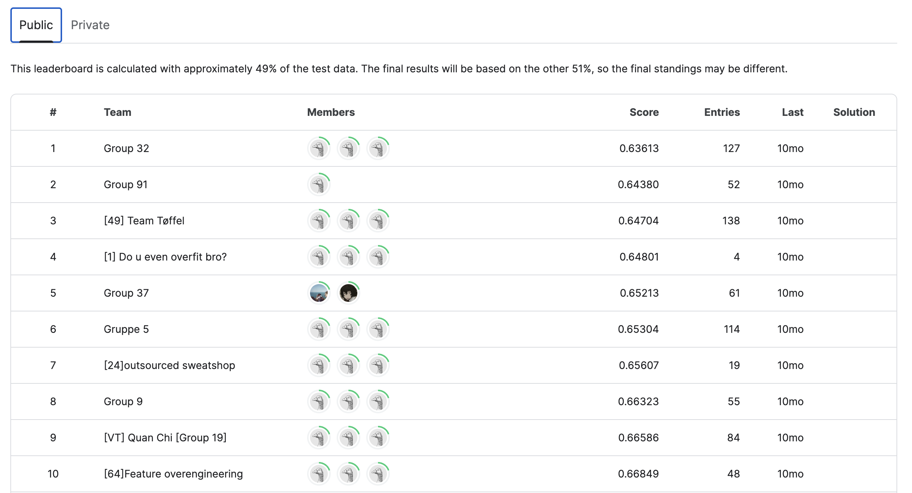

Slide 39
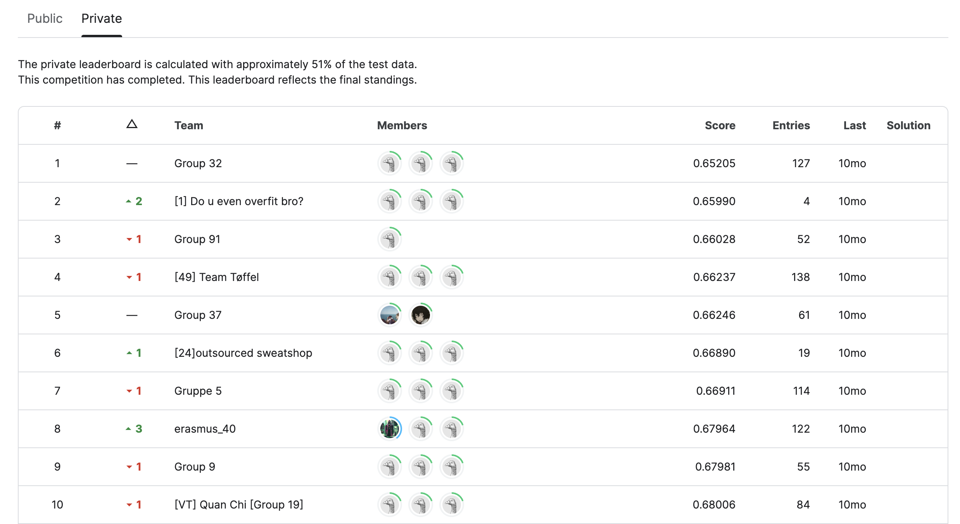

Slide 40
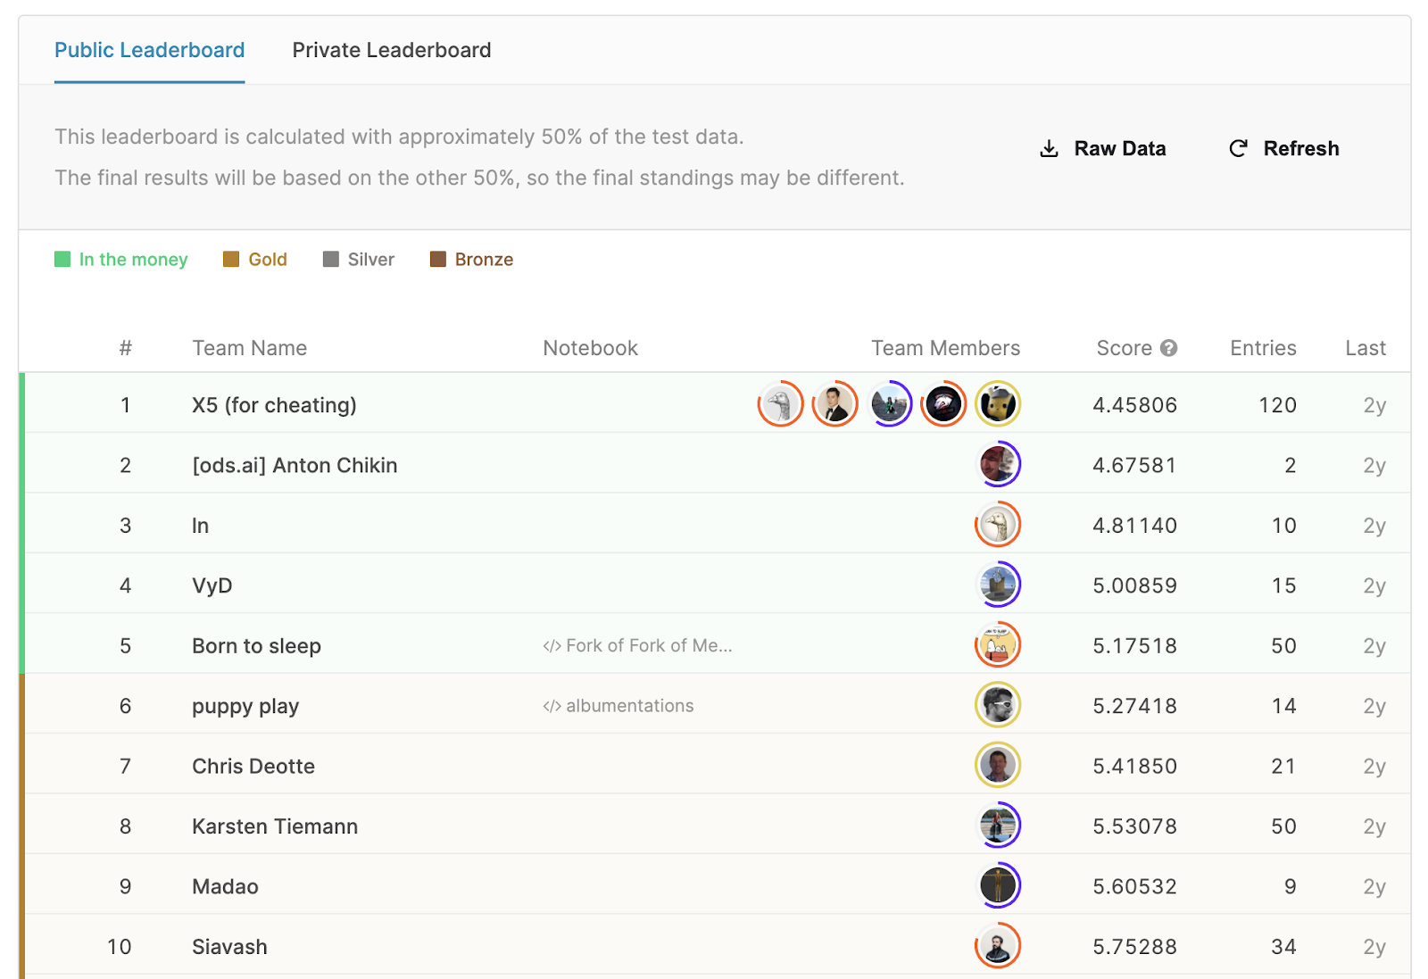

Slide 41
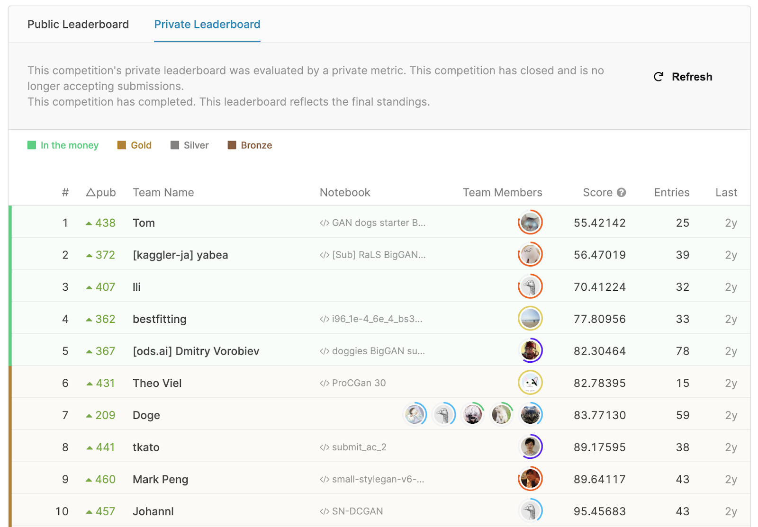


Slide 42
Outline
Purpose and task overview
Aneo
Data and task details
Evaluation
Virtual Teams
What should be delivered?
Grading

Slide 43
Outline
Purpose and task overview
Aneo
Data and task details
Evaluation
Virtual Teams
What should be delivered?
Grading
NTNU
|
Norwegian University of
Science and Technology

Slide 44




Disclaimer:
all the characters were created using Generative AI services:
Some slides have sound effects, please make sure your speakers are muted if you’re on a lecture
NO REAL IMAGES AND VOICES WERE USED

Slide 45

Press start to continue
5
2
3
4
1

Slide 46
NTNU
|
Norwegian University of
Science and Technology

Slide 47

The Story
Three brave students
Applied to the TDT4173 Machine Learning course
As a consequence, they were summoned to the mysterious Kaggle platform
To compete in a tournament
whose outcome will decide the fate of the …
COURSE GRADE
This tournament is known as
NTNU
|
Norwegian University of
Science and Technology

Slide 48

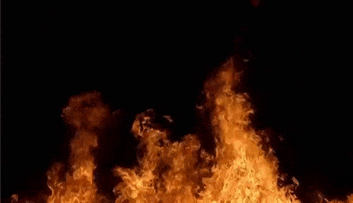
Machine
Learning
Kombat

Slide 49

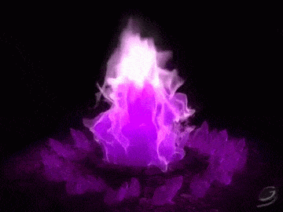
Machine
Learning
Kombat

Slide 50
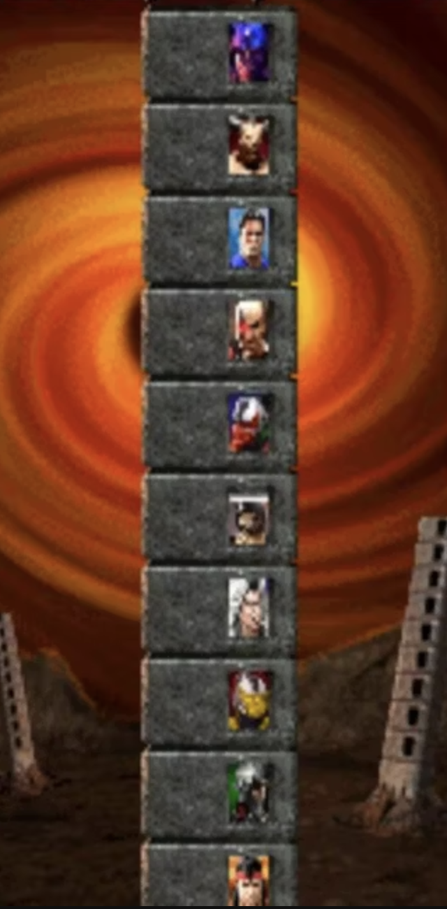
ML Kombat
10 virtual teams sorted by difficulty level
Similar to MK towers
The more virtual teams you defeat the more base points you will get
NTNU
|
Norwegian University of
Science and Technology

Slide 51
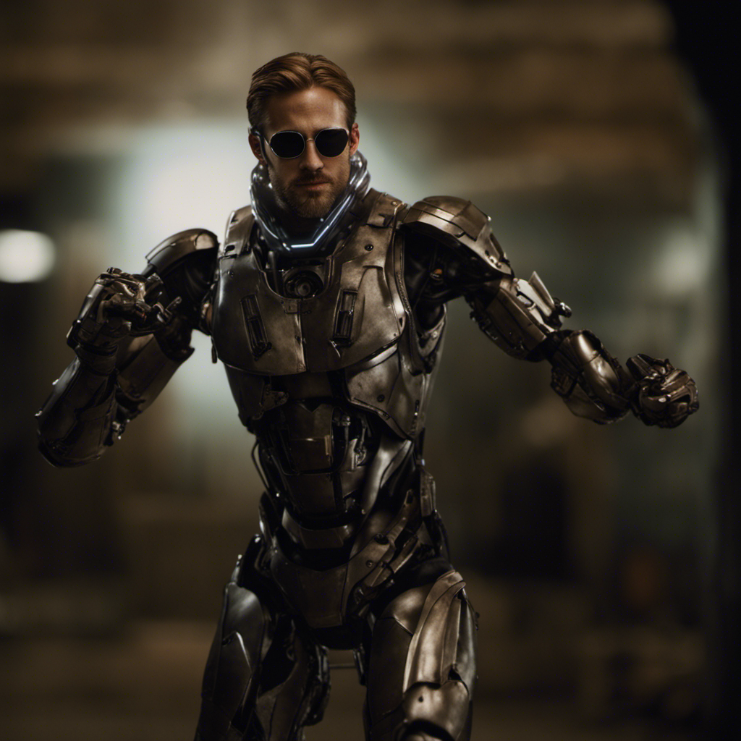







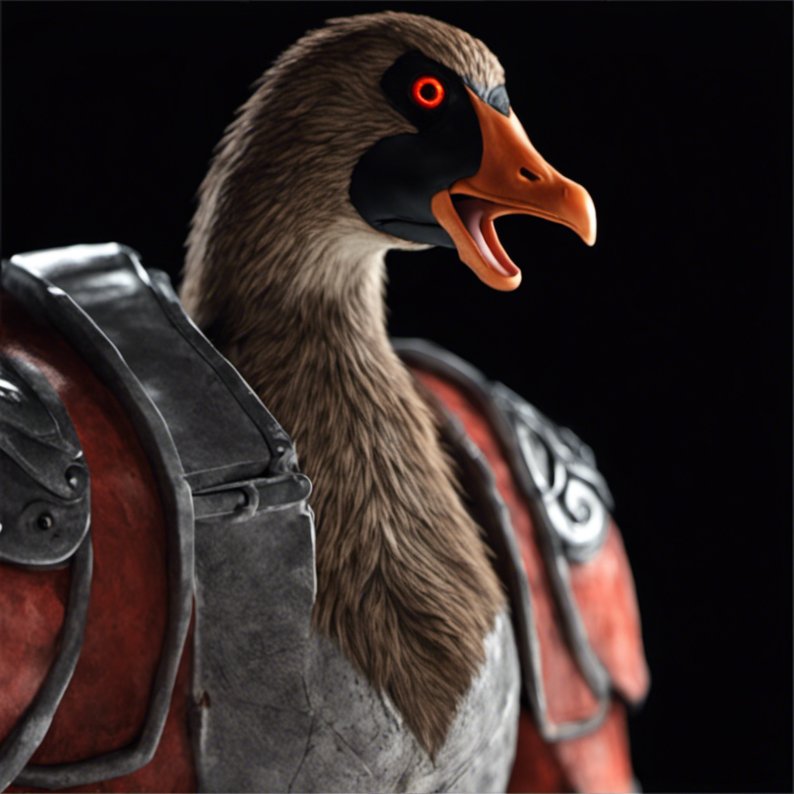


Choose Your Fighter
NTNU
|
Norwegian University of
Science and Technology

Slide 52
Choose Your Fighter
NTNU
|
Norwegian University of
Science and Technology

Slide 53



Choose Your Fighter
Modes:
- starts late
- submits solutions right before the deadline
- messy notebooks and dirty code
- screams in despair
- A chad goose
- cheats and uses external data
- asks for extension
- bites others
- start early
- working as a team
- experimenting a lot
- ask questions on piazza, seminars
NTNU
|
Norwegian University of
Science and Technology

Slide 54
Gosborg
2049
NTNU
|
Norwegian University of
Science and Technology

Slide 55
Kenshi
NTNU
|
Norwegian University of
Science and Technology

Slide 56
Quan Gos Chill
NTNU
|
Norwegian University of
Science and Technology

Slide 57
Gospion
NTNU
|
Norwegian University of
Science and Technology

Slide 58
Ryleena
NTNU
|
Norwegian University of
Science and Technology

Slide 59
Frostling
NTNU
|
Norwegian University of
Science and Technology

Slide 60
La La Lizard
NTNU
|
Norwegian University of
Science and Technology

Slide 61
KEN-O
NTNU
|
Norwegian University of
Science and Technology

Slide 62
Shao RyKhan
NTNU
|
Norwegian University of
Science and Technology

Slide 63
Goslightning
NTNU
|
Norwegian University of
Science and Technology

Slide 64














Useful combinations
EDA
Accurate preprocessing
Feature engineering
Strong models
Hyperparameters
Stacking
Results analysis
More details are in the next lectures
NTNU
|
Norwegian University of
Science and Technology

Slide 65

The VTs are not fixed yet
Frozen date is 20/10
NTNU
|
Norwegian University of
Science and Technology

Slide 66
Outline
Purpose and task overview
Aneo
Data and task details
Evaluation
Virtual Teams
What should be delivered?
Grading

Slide 67
Each group
Selects two predictions on kaggle before the deadline
Uploads Two short Jupyter notebooks:
- Only necessary steps to reproduce your selected predictions
- Naming: «short_notebook_1.ipynb»
- Put your group number!
A long Jupyter notebook:
Contains all attempts in your group work (EDA, all models, algorithms, feature engineering, results interpretation)
Submissions to Kaggle, notebooks to Blackboard

Slide 68
What can I use?
Any languages, tools, platforms, AutoML (offline), libraries, file formats during development.
But you should use Jupyter Notebook for your delivery
You can not use external data, other than we provided
Writing massive data in code is not allowed

Slide 69
Late submissions
Deadline: November 12, 2023 22:00 Central European Time (GMT+2)
Strict.
Up to this time you should submit both submissions to Kaggle and notebooks to Blackboard
Late submission deadline: 15/11/2023 22:00 CET (-10 points)
Even later = the whole group fails the course

Slide 70
Grading
Project points = base points + possible deductions
Letter | Points
A | 89-100
B | 77-88
C | 65-76
D | 53-64
E | 41-52
F | 0-40
Base points are proportional to the number of VTs defeated:
max 100 (all VTs)
min 41 (defeat 1 VT)
We use the best (out of 2 submitted) to evaluate your solution

Slide 71
Grading
Possible deductions:
Pass Individual assignment in the second chance (-5)
Late submission (-10)
No exploratory data analysis (EDA) (-3)
Only one predictor is used (-3)
No feature engineering (-3)
No model interpretation (-3)
All deductions are binary (full or no deduction)

Slide 72
Computing resources
NTNU computing resources (TAs: Erlend Hordvei and Erlend Heir)
Google Cloud Credits (TAs: Jonas Nordsrtøm and Erik Svendsmark)
The detailed instructions are going to be published on Blackboard soon...

Slide 73
Project Presentation
Ruslan Khalitov
PhD Candidate, Department of Computer Science
TDT4173 Machine Learning
Fall 2023

